Slide 1




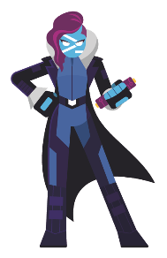





ravikanth
rchaganti
2018
2017
Configurations, Personalities, and Stamps
A modular approach to realizing the deployment pipeline
Build an immutable application infrastructure with Nano Server, PowerShell DSC, and the
release pipeline
Ravikanth Chaganti
Ravikanth Chaganti

Slide 2
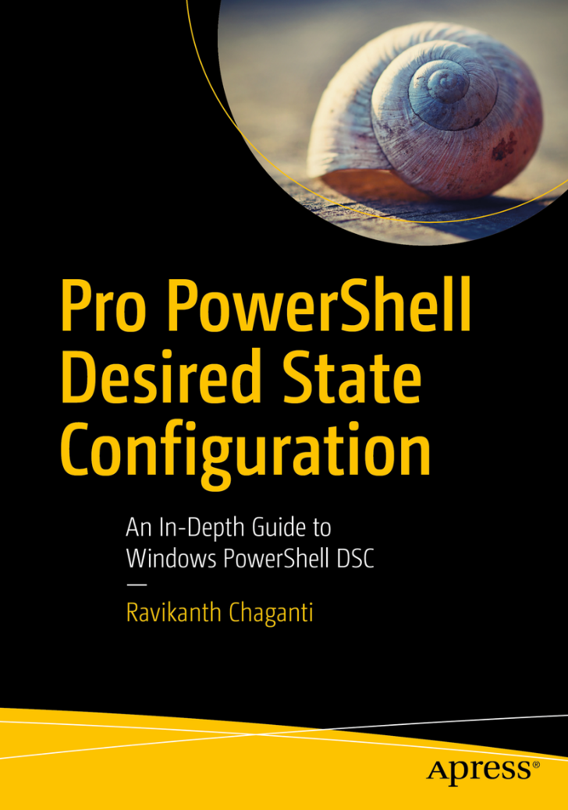
Agenda
Motivation
Concepts
Big Picture
Path Forward

Slide 3
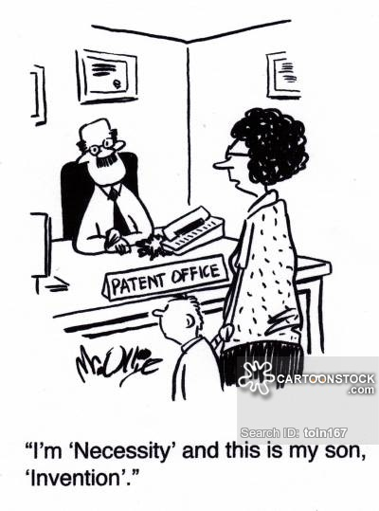
Motivation …
Spaces Direct Configuration
Spaces Direct Enablement
Cluster Configuration
Host Network
Configuration Data
OS Deploy
Node 1
Node 2
Node N

Slide 4
Big Picture
Deployment Store
Stamp
Node 1
Images
Stamp Manager
BMC
Manager
Node 2
Node N
Configuration Manager
Build Engine
Personalities
Configurations

Slide 5
Configurations
Configurations
Not just simple DSC configurations!
Packaged as composite resource modules
Discoverability is key!
And, they are reusable.
Not just configurations but cover the entire deployment pipeline
C1
C2
C3
C4
CN
https://github.com/rchaganti/infrablueprints

Slide 6
Personalities
S2D HCI Primary
S2D HCI Participant
C1
C1
C2
C2
C3
C3
C4
CN
Don’t confuse with the pet vs cattle thing!
Personalities are immutable!

Slide 7
Stamps
Combine personalities to build to stamps!
S2D HCI Primary
S2D HCI Participant 1
S2D HCI Participant 2
C1
C1
C1
C2
C2
C2
C3
C3
C3
C4
CN
Configuration Data

Slide 8
Path Forward
Complete the Stamp DSL!
Move to a NoSQL database
Enable deployment history
Automate documentation – PlatyPS!?
Implement REST methods for interaction between the deployment station and nodes
Polaris
Universal Dashboard
Reporting!

Slide 9
Summary
Using composite resources helps abstract the DSC resource granularity.
Enables a modular approach to configuring systems in a deployment pipeline.
Ability to replace build engine
Abilitity to switch between physical and virtual deployments

Slide 10
Questions?

Slide 11

Next Steps
DO NOT FORGET
Now: 15 min break
Grab a coffee
Stay here to enjoy next presentation
Change track and switch to another room
Ask me questions or meet me in a breakout session room afterwards

